Slide 1
Depression Detection with Speech Analysis (Mobile App)
Sim Yu Hui, Kellie | S10163148E
Tan Hong Ray | S10177638K
Diploma in Engineering Science | PS06

Slide 2

Depression Detection with Speech Analysis (Mobile App)

Slide 3

Depression Detection with Speech Analysis (Mobile App)
1 in 7 Singaporeans have experienced a mental illness in their lifetime

Slide 4
Depression Detection with Speech Analysis (Mobile App)

Slide 5
Depression Detection with Speech Analysis (Mobile App)
Other mental disorders
Depression 44%

Slide 6
80% do not seek help

Slide 7
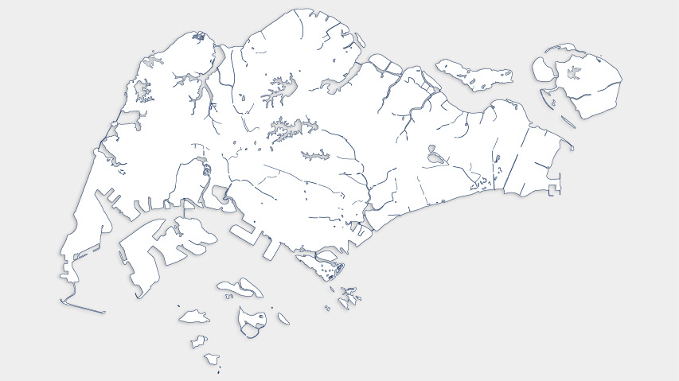
Depression Detection with Speech Analysis (Mobile App)

Slide 8
Depression Detection with Speech Analysis (Mobile App)
Provide quantitative information that complements existing methods of detecting depression

Slide 9
Help people affected by depression on a day to day basis

Slide 10
Reduce cost incurred due to prolonged and expensive medical treatments

Slide 11
Create an easy and accessible way to detect depression

Slide 12
Depression Detection with Speech Analysis (Mobile App)
Our Solution

Slide 13
Depression Detection with Speech Analysis (Mobile App)
Our Solution

Slide 14




Depression Detection with Speech Analysis (Mobile App)

Slide 15
Depression Detection with Speech Analysis (Mobile App)
Application on phone sends PCM data to server

Slide 16
Depression Detection with Speech Analysis (Mobile App)
Server receives PCM data

Slide 17
Depression Detection with Speech Analysis (Mobile App)
PCM data converted into a spectrogram, which is processed

Slide 18
Depression Detection with Speech Analysis (Mobile App)
Spectrogram is fed into CNN model and prediction is returned

Slide 19
Depression Detection with Speech Analysis (Mobile App)
Application receives and displays prediction on screen

Slide 20
Depression Detection with Speech Analysis (Mobile App)
How it works

Slide 21
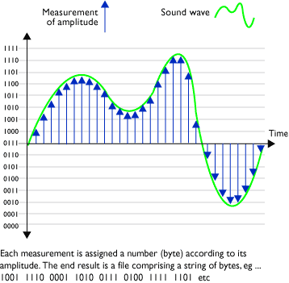
Depression Detection with Speech Analysis (Mobile App)
How it works
Audio Recording
Records PCM data.
Sample rate used: 8000Hz (8000 samples per second) and 16 bit per sample
Number of channels used: 1 (Mono)
Instantaneous amplitude at each sampling was used in our audio visualisation
Notes:
Pulse Code Modulation (PCM) allows us to get a digital representation of an analog signal
It takes samples of the amplitude of the analog signal at regular intervals

Slide 22
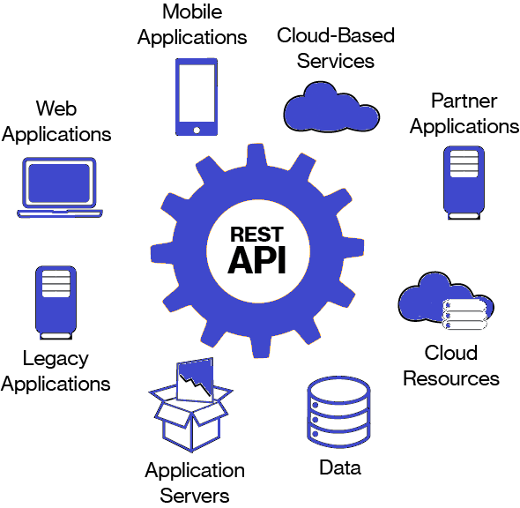
Depression Detection with Speech Analysis (Mobile App)
How it works
Backend Server
Calls RESTful APIs from a backend server hosted on an Amazon Elastic Cloud 2 (EC2) instance
API takes in PCM file, and returns prediction of audio
When server runs, model generated will be loaded
Our prediction – a JSONObject (key, value pair of data) will be returned to the application

Slide 23
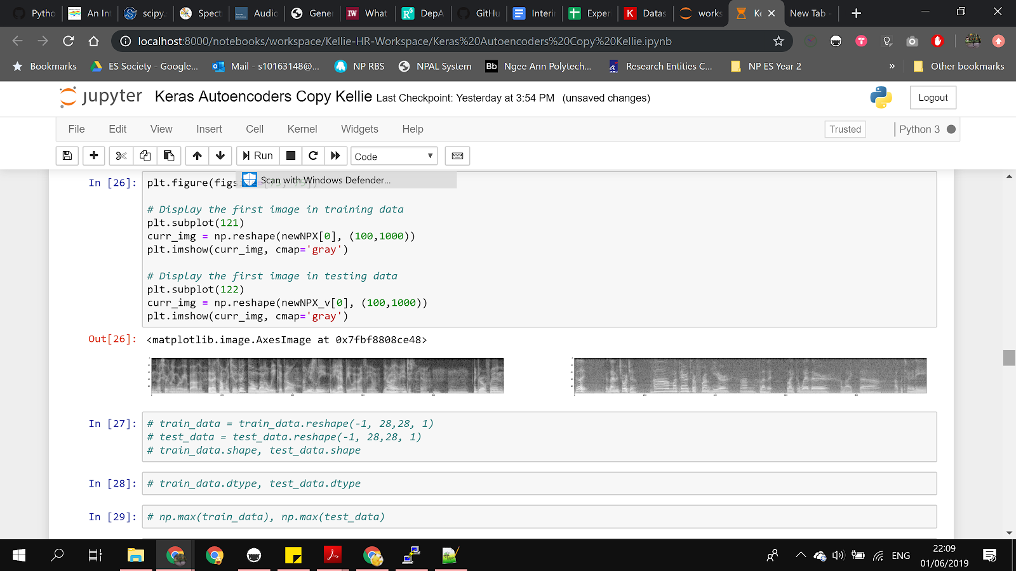
Depression Detection with Speech Analysis (Mobile App)
How it works
Spectrogram Generation
PCM Data
PCM data is converted into .wav file on server
Spectrogram used as it contains a high level of detail from the audio file
Grayscale spectrograms are used so as to reduce the computational demand

Slide 24
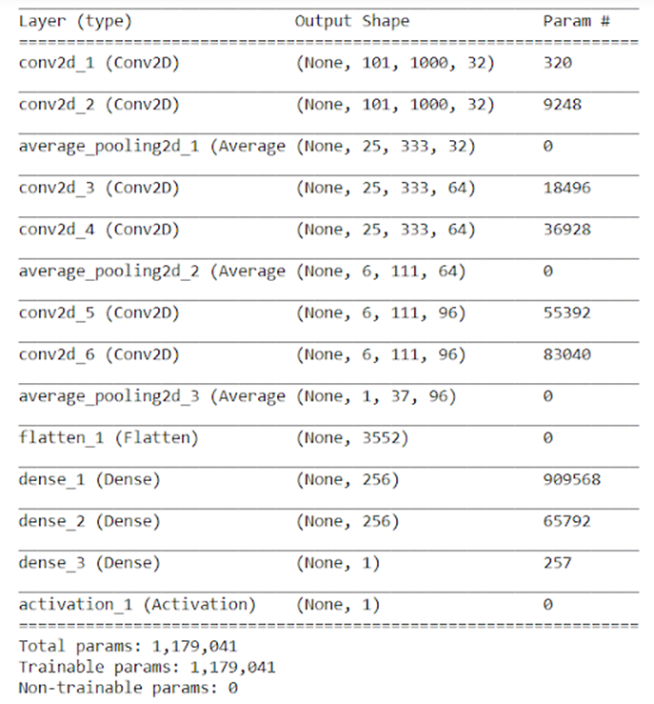
Depression Detection with Speech Analysis (Mobile App)
How it works

Slide 25
Depression Detection with Speech Analysis (Mobile App)
How it works
Convolution

Slide 26
Depression Detection with Speech Analysis (Mobile App)
How it works
Convolution
Preserves spatial relationship between pixels by learning image features using small squares of input data
Extracts features from input
Size of convolved feature is controlled by: depth (number of filters), stride (number of pixels by which filter is slid), zero-padding (around border)
Element wise multiplication and addition
Activation layer at the end

Slide 27
Depression Detection with Speech Analysis (Mobile App)
How it works
Dense/Fully Connected
Regular layer of neurons in a neural network
Each neuron receives input from all the neurons in the previous layer
Represents matrix vector multiplication
Every input is connected to every output by a weight

Slide 28
Depression Detection with Speech Analysis (Mobile App)
How it works
Flatten
Remove all dimensions except for one
Reshapes tensor to have a shape that is equal to the number of elements contained in it

Slide 29
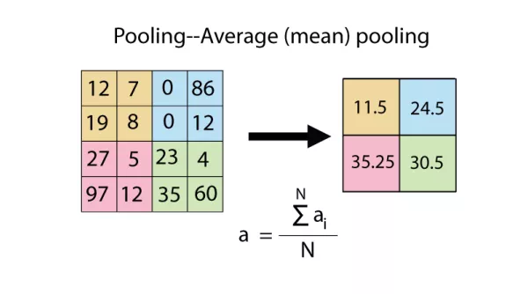
Depression Detection with Speech Analysis (Mobile App)
How it works
Average Pooling

Slide 30
Depression Detection with Speech Analysis (Mobile App)
How it works
Average Pooling
Reduces dimensionality of each feature map but retains most important information
Makes the network invariant to small transformations, distortions and translations in the input image
Allows us to detect objects in an image no matter where they are located

Slide 31
Depression Detection with Speech Analysis (Mobile App)
How it works
Activation
Decides whether a neuron should be activated by calculating the weighted sum and further adding bias with it
Introduces non-linearity into the output of a neuron
Sigmoid function is used so that output will always be within 0 and 1

Slide 32
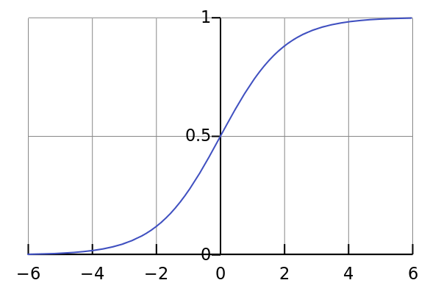

Depression Detection with Speech Analysis (Mobile App)
How it works
Activation

Slide 33
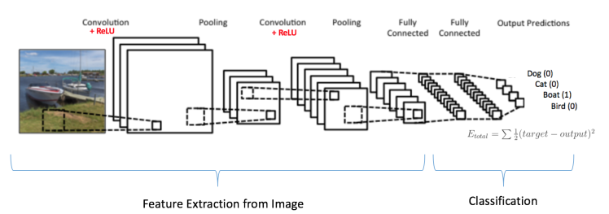
Depression Detection with Speech Analysis (Mobile App)
How it works

Slide 34
Depression Detection with Speech Analysis (Mobile App)
How it works
However, with this, our accuracy was only 55%

Slide 35

Depression Detection with Speech Analysis (Mobile App)
Optimisation

Slide 36

Depression Detection with Speech Analysis (Mobile App)
Optimisation
k-fold Cross Validation

Slide 37
Depression Detection with Speech Analysis (Mobile App)
Optimisation
Standard Validation
Training Set
Test Set

Slide 38
Depression Detection with Speech Analysis (Mobile App)
Optimisation
5-fold Cross Validation
Data set

Slide 39
Depression Detection with Speech Analysis (Mobile App)
Optimisation
5-fold Cross Validation
Training set
Test set

Slide 40
Depression Detection with Speech Analysis (Mobile App)
Optimisation
5-fold Cross Validation
Training set
Test set

Slide 41
Depression Detection with Speech Analysis (Mobile App)
Optimisation
5-fold Cross Validation
Training set
Test set

Slide 42
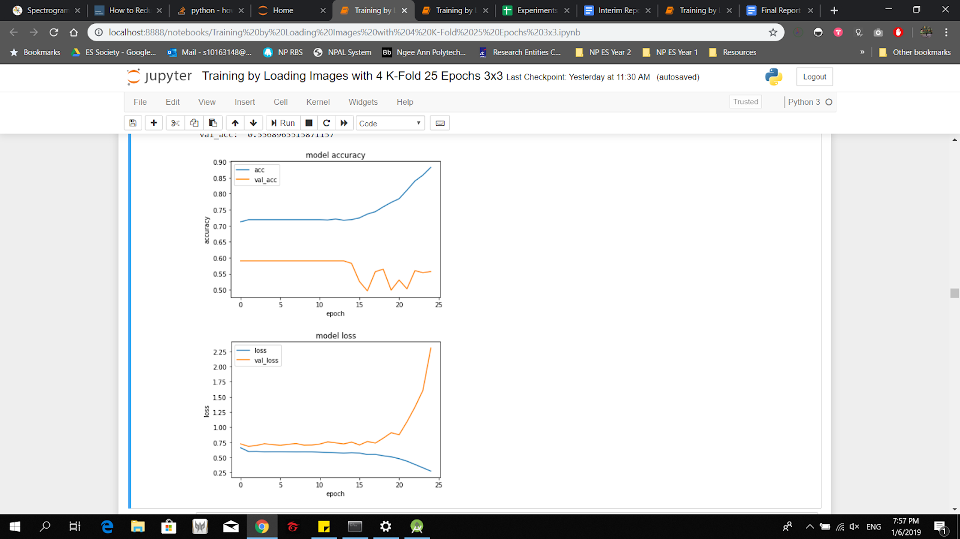
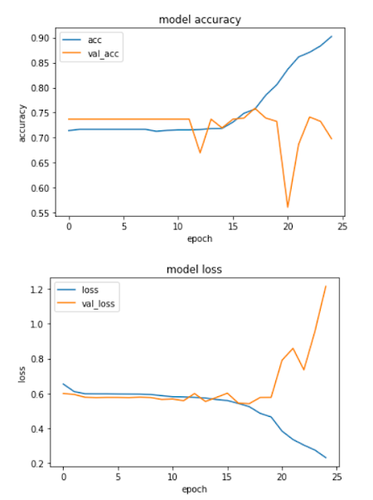
Depression Detection with Speech Analysis (Mobile App)
Optimisation
Without K-Fold
With K-Fold

Slide 43
Depression Detection with Speech Analysis (Mobile App)
Optimisation

Slide 44
Depression Detection with Speech Analysis (Mobile App)
Optimisation

Slide 45
Depression Detection with Speech Analysis (Mobile App)
Optimisation

Slide 46
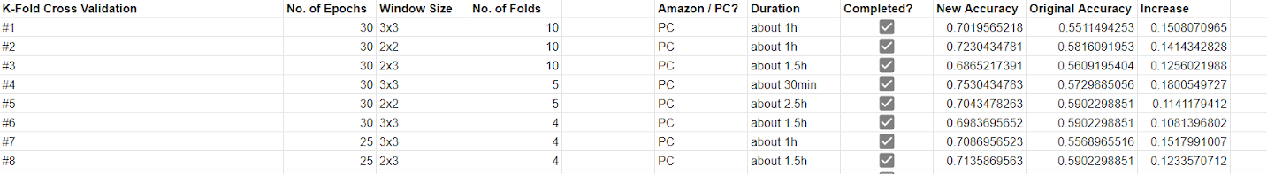
Depression Detection with Speech Analysis (Mobile App)
Optimisation

Slide 47
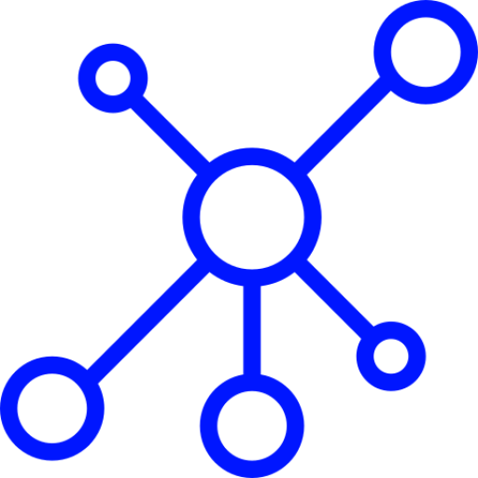
Depression Detection with Speech Analysis (Mobile App)
Optimisation
Generative Adversarial Networks (GANs)

Slide 48
Depression Detection with Speech Analysis (Mobile App)
Optimisation

Slide 49
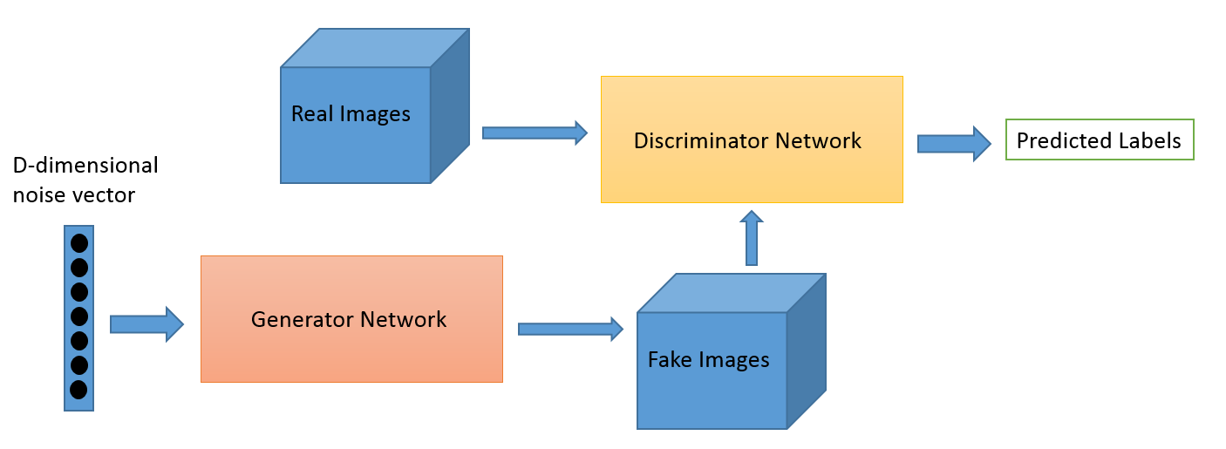
Depression Detection with Speech Analysis (Mobile App)
Optimisation

Slide 50
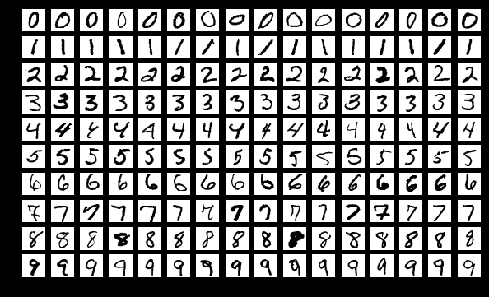
Depression Detection with Speech Analysis (Mobile App)
Optimisation
MNIST Dataset

Slide 51
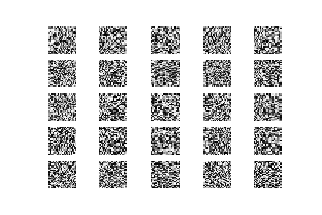
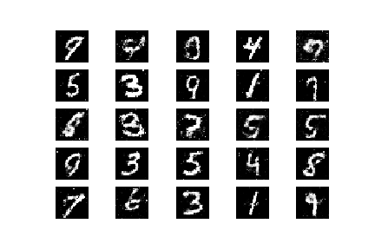
Depression Detection with Speech Analysis (Mobile App)
Optimisation
Outputs from generator
1st epoch
20th epoch

Slide 52

Depression Detection with Speech Analysis (Mobile App)
Optimisation
Autoencoders

Slide 53
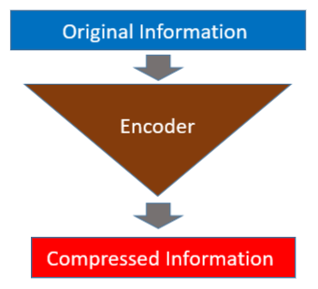
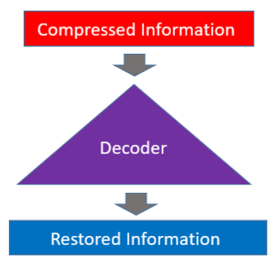
Depression Detection with Speech Analysis (Mobile App)
Optimisation
Encoder
Decoder

Slide 54
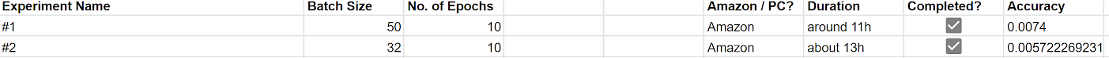
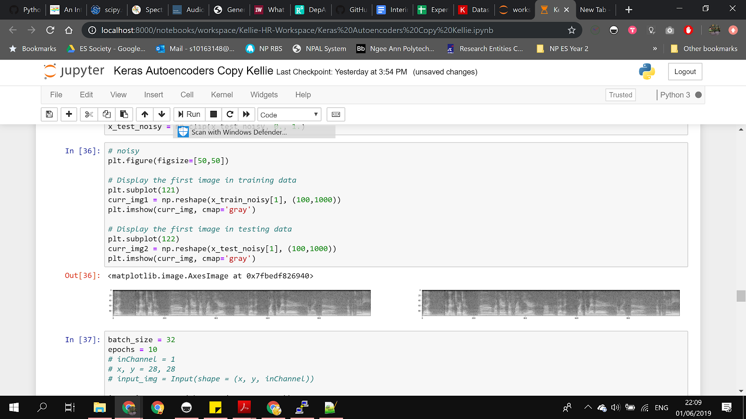
Depression Detection with Speech Analysis (Mobile App)
Optimisation
Before
After
Before
After

Slide 55



Depression Detection with Speech Analysis (Mobile App)
Problems Faced

Slide 56
Depression Detection with Speech Analysis (Mobile App)
Not enough Vram
Hardware limitations
Low accuracy (autoencoder)

Slide 57
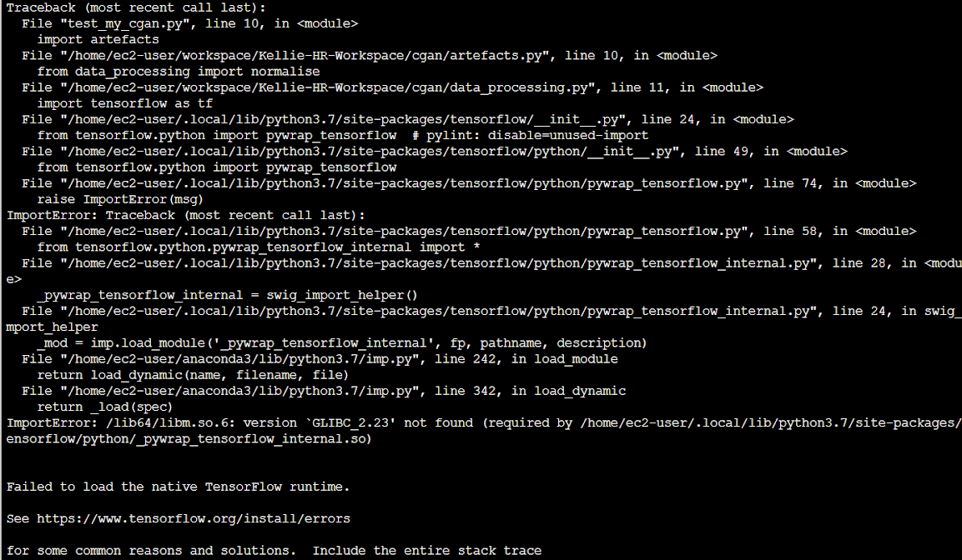
Depression Detection with Speech Analysis (Mobile App)

Slide 58

Depression Detection with Speech Analysis (Mobile App)
Future Plans

Slide 59
Depression Detection with Speech Analysis (Mobile App)
Improve the accuracy of denoising tools – autoencoder and GANs
Display real time spectrogram on phone
Test out different implementation of GAN (STARGAN)
Test different durations of audio signal

Slide 60
Special thanks to: Dr Harry Nguyen and Dr Pham the Hanh
Depression Detection with Speech Analysis (Mobile App)

Slide 61
References
Depression Detection with Speech Analysis (Mobile App)
https://dzone.com/storage/temp/4801566-infographic-3.png
https://medium.com/the-theory-of-everything/understanding-activation-functions-in-neural-networks-9491262884e0
https://ujjwalkarn.me/2016/08/11/intuitive-explanation-convnets/
https://towardsdatascience.com/train-test-split-and-cross-validation-in-python-80b61beca4b6
http://skymind.ai/wiki/generative-adversarial-network-gan
https://towardsdatascience.com/how-to-reduce-image-noises-by-autoencoder-65d5e6de543
https://machinelearningmastery.com/evaluate-performance-deep-learning-models-keras/
https://towardsdatascience.com/cross-validation-70289113a072

